Slide 1
Design Brief: Availability of Computers at the New School
Shin Han
MFA Design and Technology
February 8, 2010

Slide 2
Problem Statement
Computer labs at the New School do not have a systematic method of finding available computers for students.

Slide 3
Problem Description
1 location that shows the “Computer Availability”
7 computer lab locations
310 computers at the New School
9,825 students at the New School

Slide 4
Evidence/Research
Monitored the “Computer Availability” screen
Feb. 4th, Thursday at 3:15pm
Feb. 7th, Sunday at 12:55pm
Feb. 8th, Monday at 12:55pm

Slide 8
Evidence/Research
Spoke with Marko Kocic (lab aid) and Emre Balik (manager) on the 3rd Fl. Lab of 55 W. 13th Street
“Computer Availability” monitor is online as well, but only accessed by staff members.
8th floor audio/video editing computers can be reserved online.
Go to 7th floor: send e-mail to at@newschool.edu

Slide 9
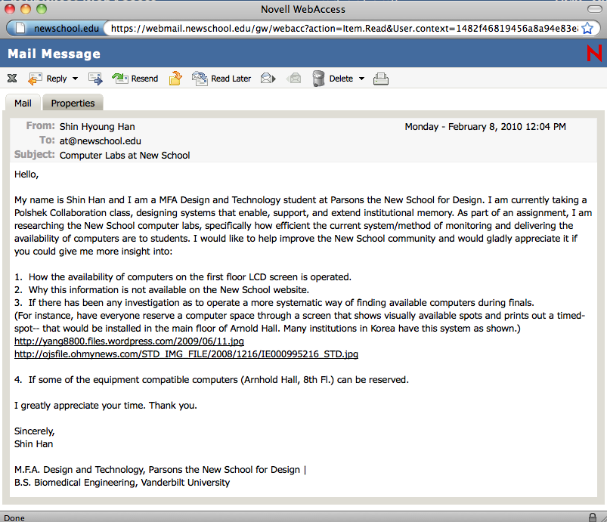
Evidence/Research
3. E-mailed Academic Technology
No response

Slide 10
Results
Students mainly use computers on the 3rd and 8th floor of 55 W. 13th Street.
Peak-time: around noon on weekdays
Most students who entered 55 W. 13th Street did not view the “Computer Availability” monitor.
Students are unaware of the “Computer Availability” screen on 55 W. 13th St., therefore, wander around computer labs.

Slide 11
Conclusion
“Computer Availability” monitor should be accessible in more locations.
Create a system that guarantees students a computer station.
Allows students to reserve stations for a timed-period

Slide 12
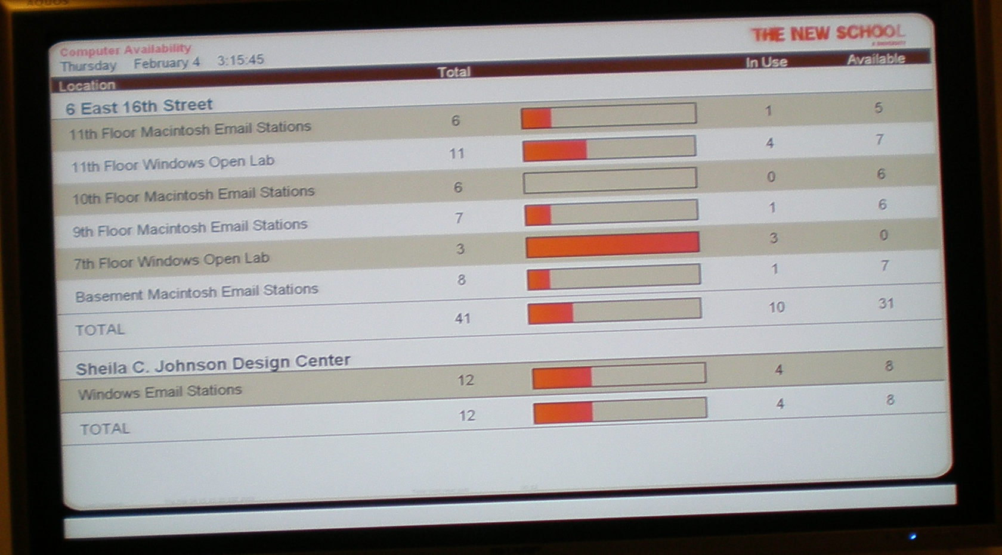

Slide 13
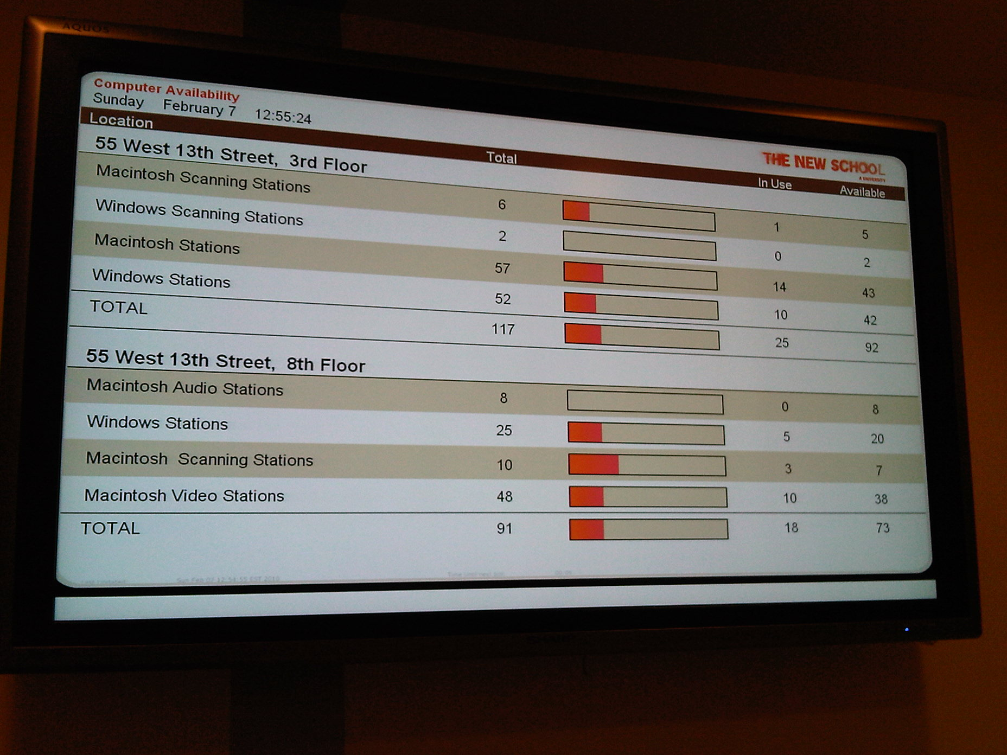
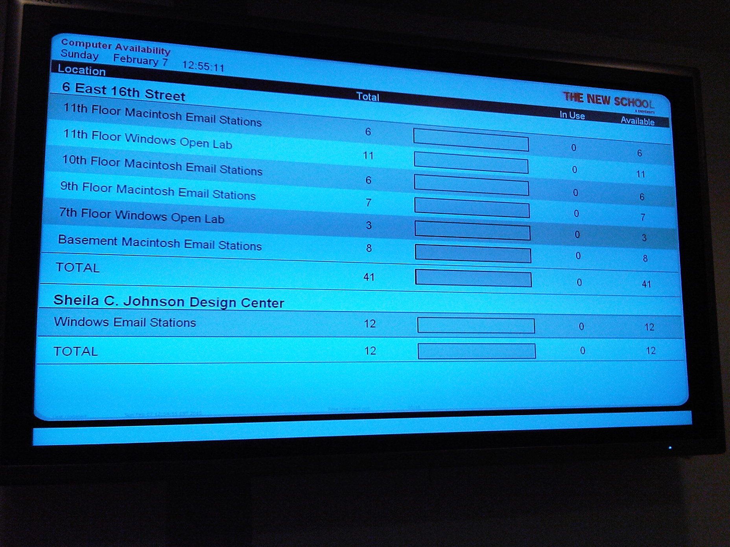

Slide 14
