Slide 2
LAB SERVICES
Shin Han
Karen Everett
Isadora Dantas
Polshek Design Collab
MFA Design and Technology

Slide 3
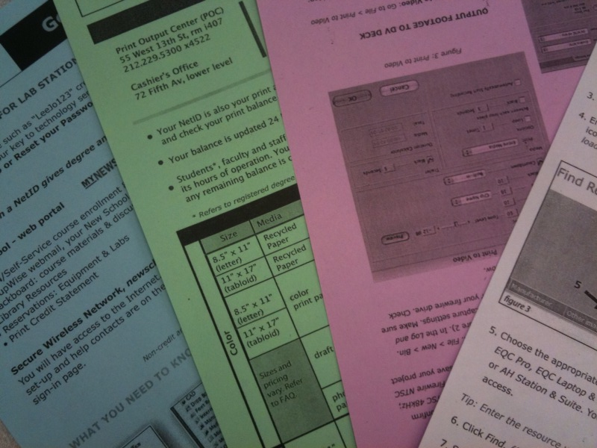
Problems stated:
Students are unaware of the “Computer Availability” screen on 55 W. 13th St., therefore, wander around computer labs;
People abandon computers, making it even worse to find a computer available;
The information that would make the use of labs easier is available, but not so clear to be easily found.

Slide 4
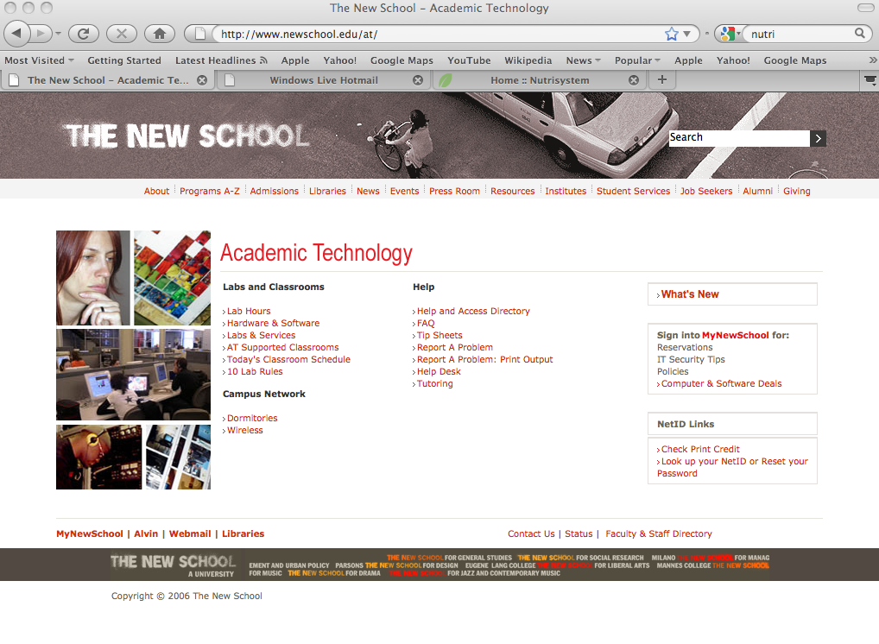
Methodology:
Arrange a meeting with the Academic Technology’s director to verify the possibility of make the availability of computers public, so the students could access it outside the school.

Slide 5
What was discussed:
A software called “LabStats” is used to monitor the computer use at the New School.
Because of firewall, the LabStat information on available computer has limited access (currently only to staffs).
There are “express stations” around campus, used for quick prints and e-mails. AT is currently working on making more express stations
The “In Use” signs have been abused, therefore, will not allowed to be used in computer labs anymore.
Wireless printers are not available yet because of technical difficulties.
Change the “utility stations,” which fixes hard drive problems, to “informative stations” to inform students on computer labs and resources available.

Slide 6
Did you know:
You can previously check the availability of computers in all the labs without going there: At the screens located in every building lobby there are the indications of availability of computers. All you need to do is wait until the screen appear instead of wasting your time going to the lab and check it by yourself
You can know which software are available and where: At the Academy Technology website there’s a list of the software provided on the labs and where you can find them. There’s even a map of each lab.
You can reserve your computer: If you need a computer with audio or instruments attached, you can reserve them anytime at your my.newschool account
You can’t leave your stuff at a computer in order to reserve it. One thing is go to the bathroom, other is to leave your belongings in front a computer and do something else. If you notice that a computer’s been left for more than 30min, you can report it to staff member and they’ll free it to you.

Slide 7
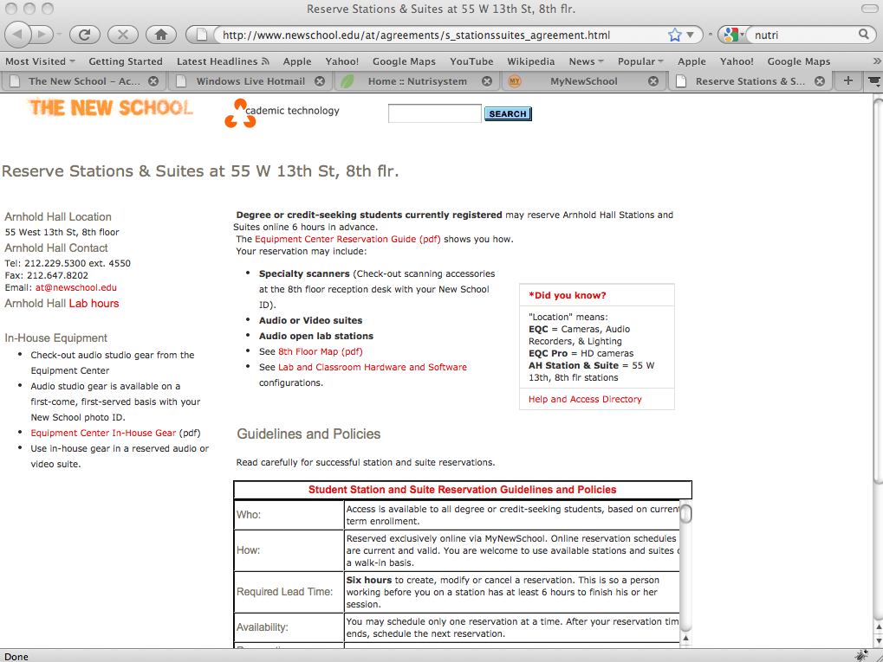
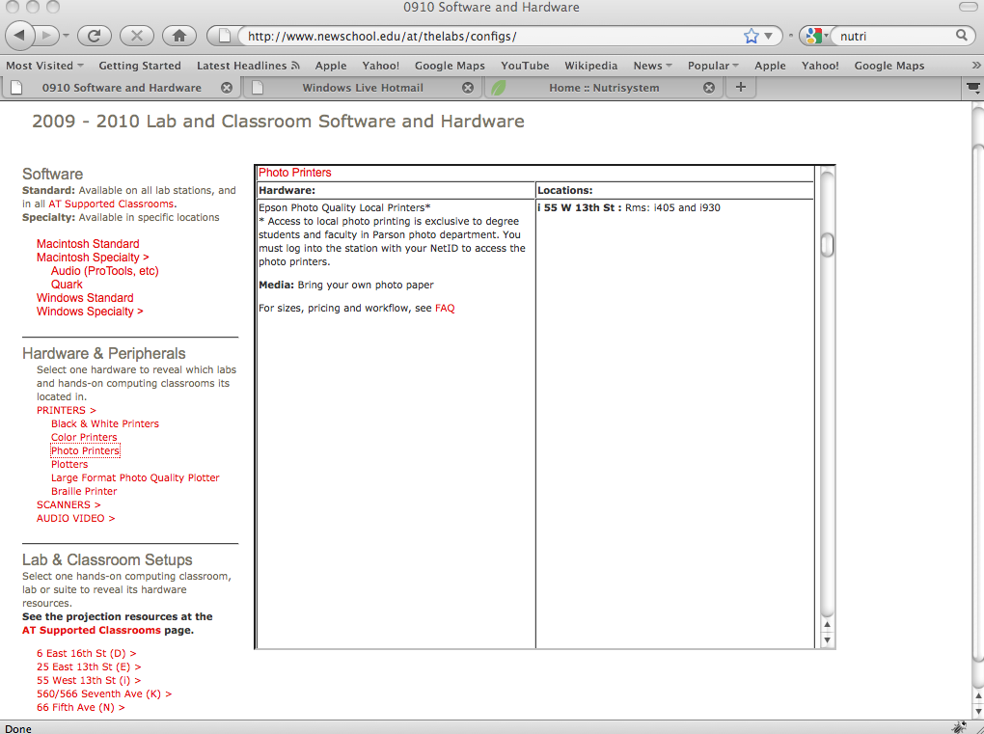
Reaction:
In fact, everything that you needed to know about computer labs, it’s really out there. However, it’s hard to find out about them by your own.

Slide 8
Design Approach:
Since we already have the information available, we decided that the best design product would be a pamphlet with a sum up of everything and where to find it. This flyer would be located on the labs to everybody to grab.

