Slide 1
Polshek Partnership Architects
Makenzie Rasmussen
Spencer Black
Isadora Dantas

Slide 2
Issues/ Problems
Lack of Committee Presence
Committee Storefront
New place for social/ event updates besides email
Connect photos with projects
Easier/ convenient way to update photos
Project details and reference
Get to know employees and skills
Inspirational references

Slide 3
Goals
Create a professional network specifically to achieve Polshek’s needs of sharing work and optimizing time.
Incentive to upload and learn from others
Inform people about upcoming events
Create a storefront for committees
Decrease the number of emails (via chat and discussion boards)
Create a space for project details to make communication more efficient

Slide 4
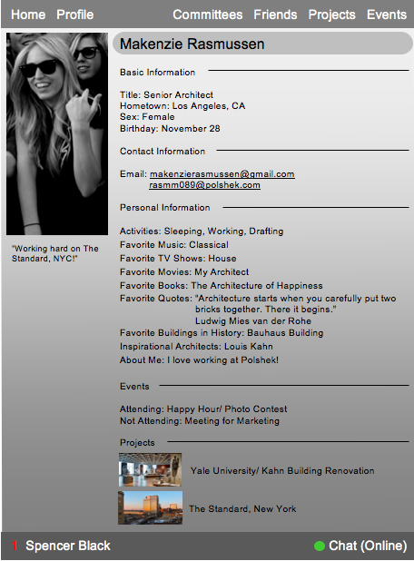
Profiles
Short employee status updates
Personal/ Contact Information
Projects in progress or past projects
Events attending/ not-attending
Committee within
Profile picture
Company network based off ID names

Slide 5
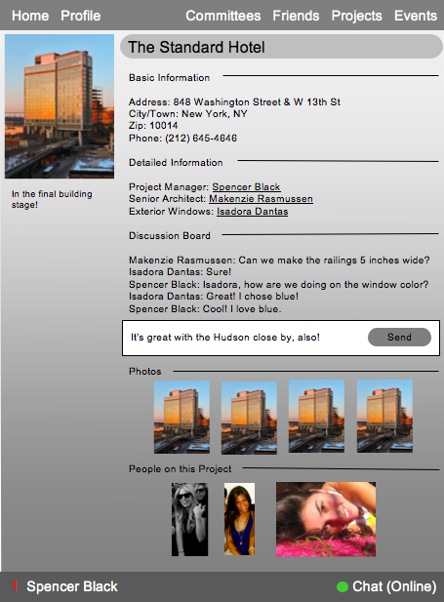
Project Page
Basic Information
Position titles/ employees involved
Short status of project details
Pictures available of project
Discussion board for people working on project

Slide 6
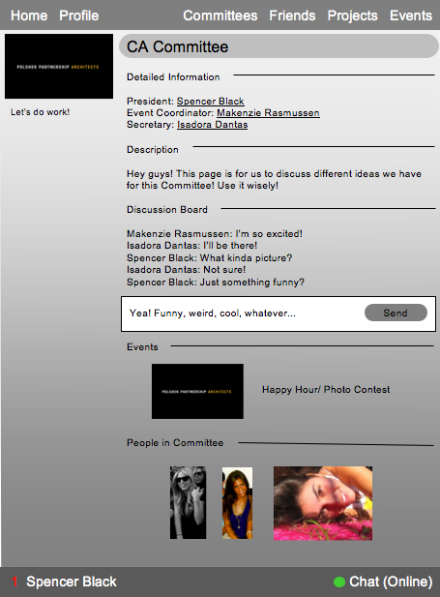
Committee Page
Provide a discussion board for committee members
Description of committee actions
Information Updates
Job title descriptions/ link to employees
Committee can add events

Slide 7
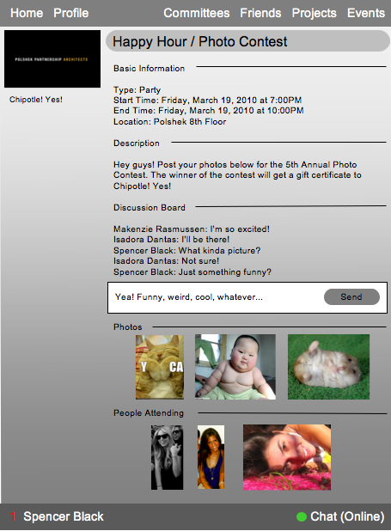
Event Page
Event information details
Discussion board
Alerts/ Updates
People can attend or decline events

Slide 8
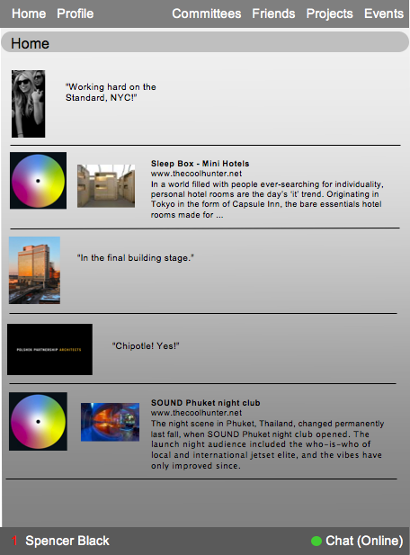
Home Page
Sharing network
Member Updates
Project Updates
Committee News
Event Alerts
Use RSS feeds from design sites for inspiration

Slide 9
Next Steps
Design Interface Prototype
Create pages for each committee/ project/ profile/ event
Create interactivity within network
Make changes based on class feedback

Slide 10
The End
Thank you for listening!

